Slide 1
MyKAD SDK ACS Reader
The Java driver
First Import into project
ACS Driver high level summary
Each ACS Driver procedures
APDU MyKad commands
Mockup Interface

Slide 2
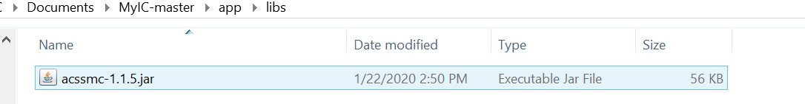
Include ACS all supported Android Driver

Slide 3
First Import[Suffice for Soliduz myKad ACS SDK]
import com.acs.smartcard.Reader;
import com.acs.smartcard.Reader.OnStateChangeListener;

Slide 4
High Level Summary of ACS Reader Driver
Initialize reader object by Android USBManager
Detect Card Application. Must be READER.CARD_SPECIFIC for Operation
Open Reader
Resetting Reader. 0=Pwr down, 1= Cold Reset, 2= Warm Reset
Setting Protocol [if not READER.CARD_SPECIFIC] or Select T0 default
Transmit APDU
CLOSE READER

Slide 5
Package com.acs.smartcard Description
To create and initialize a Reader object, get an instance of UsbManager by calling Context.getSystemService().
/** Called when the activity is first created. */
@Override
public void onCreate(Bundle savedInstanceState) {
super.onCreate(savedInstanceState);
setContentView(R.layout.activity_main);
// Get USB manager
mManager = (UsbManager) getSystemService(Context.USB_SERVICE);
// Initialize reader
mReader = new Reader(mManager);

Slide 6
Package com.acs.smartcard Description [Continue]
If you want to detect a card in your application, you can supply a Reader.OnStateChangeListener object to Reader object.
mReader.setOnStateChangeListener(new OnStateChangeListener() {
@Override
public void onStateChange(int slotNum, int prevState, int currState) {
if (prevState < Reader.CARD_UNKNOWN
|| prevState > Reader.CARD_SPECIFIC) {
prevState = Reader.CARD_UNKNOWN;
}
if (currState < Reader.CARD_UNKNOWN
|| currState > Reader.CARD_SPECIFIC) {
currState = Reader.CARD_UNKNOWN;
}
// Create output string
final String outputString = "Slot " + slotNum + ": "
+ stateStrings[prevState] + " -> "
+ stateStrings[currState];
// Show output
runOnUiThread(new Runnable() {
@Override
public void run() {
logMsg(outputString);
}
});
}
});

Slide 7
Opening Reader
for (UsbDevice device : mManager.getDeviceList().values()) {
if (mReader.isSupported(device)) {
mReaderAdapter.add(device.getDeviceName());
}
}
// For each device
for (UsbDevice device : mManager.getDeviceList().values()) {
// If device name is found
if (deviceName.equals(device.getDeviceName())) {
// Request permission
mManager.requestPermission(device,
mPermissionIntent);
requested = true;
break;
}
}
To open a reader, you need to get a UsbDevice object from UsbManager and request a permission to access the device or discover a device using intent filter. For more information, please refer to USB Host from Android Dev Guide.

Slide 8
Resetting Card Reader
Before transmitting APDU command, you need to power up a card first. The ATR string will be returned if the card is operated normally. Otherwise, it will throw a exception to indicate the error. Use warm reset Flag action 2 for frequent use
protected ReadIcResult doInBackground(ReadIcParams... params) {
ReadIcResult result = new ReadIcResult();
try {
byte[] atr = mReader.power(params[0].slotNum, 2); // 1 Cold Reset 2 Warm Reset
} catch (Exception e) {
result.e = e;
return result;
}
sendApdu(params[0].slotNum, "00 A4 04 00 0A A0 00 00 00 74 4A 50 4E 00 10", params[0].debug);//JPN application, CLA INS P1 P2 P3, 4A 50 4E is JPN
sendApdu(params[0].slotNum, "00 C0 00 00 05", params[0].debug); //GET_RESPONSE
sendApdu(params[0].slotNum, "C8 32 00 00 05 08 00 00 35 00", params[0].debug);//Set Length
sendApdu(params[0].slotNum, "CC 00 00 00 08 01 00 01 00 E9 00 35 00", params[0].debug);//Select info
byte[] jpn1_1 = sendApdu(params[0].slotNum, "CC 06 00 00 35", params[0].debug); //Read info
if (jpn1_1.length >= 0x35) {//Check return Reader must met this length
result.name = new String(jpn1_1, 0, 40).trim();
result.ic = new String(jpn1_1, 40, 13).trim();
}
return result;
}

Slide 9
ACS/MyKAD PCSC ADPU reader high level
Select Application
JPN_APPLICATION = "00 A4 04 00 0A A0 00 00 00 74 4A 50 4E 00 10";
//CLA INS P1 P2 P3, 4A 50 4E is JPN
Get Response
GET_RESPONSE = "00 C0 00 00 05";
Set Length
C8 32 00 00 05 08 00 00 28 00
Select Info
CC 00 00 00 08 01 00 01 00 E9 00 28 00
Green is length
Red is offset
Blue is jpn1-1 based on
Read Info
CC 06 00 00 28

Slide 10
Setting Protocol
public void onStateChange(int slotNum, int prevState, int currState) {
if (prevState < Reader.CARD_UNKNOWN
|| prevState > Reader.CARD_SPECIFIC) {
prevState = Reader.CARD_UNKNOWN;
}
if (currState < Reader.CARD_UNKNOWN
|| currState > Reader.CARD_SPECIFIC) {
currState = Reader.CARD_UNKNOWN;
}
// Create output string
final String outputString = "Slot " + slotNum + ": "
+ stateStrings[prevState] + " -> "
+ stateStrings[currState];
// Show output
runOnUiThread(new Runnable() {
@Override
public void run() {
logMsg(outputString);
}
});
After powering up the card, the card state is changed to Negotiable (Reader.CARD_NEGOTIABLE) or Specific (Reader.CARD_SPECIFIC). You cannot transmit a APDU command if the card state is not equal to Specific. To select a protocol, invoke Reader.setProtocol() method with preferred protocols.
If Reader need to be force to set CARD Protocol
They are referred to as T=0 and T=1. Both protocols are half-duplex (one direction at a time), asynchronous communications. The T=0 protocol is a character-based format, while T=1 is a block-based format. All EMV-compliant smart cards must support the T=0 or T=1 protocols, while terminals must support both. If no protocol is specified, T=0 is assumed. NOTE, MyKAD is string based ASCII code based

Slide 11
Setting Protocol [Continue] Sample only not to be used in ACS-device
setProtocol public int setProtocol(int slotNum,
int preferredProtocols)
throws ReaderException
Sets the protocol.
Parameters: slotNum - the slot number. preferredProtocols - the preferred protocols. It can be combined with OR operation. For example, PROTOCOL_T0 | PROTOCOL_T1. Returns: the active protocol. Either PROTOCOL_T0 or PROTOCOL_T1. Throws: ReaderException - if the reader is failed to set protocol.
Sample Code
public void setProtocol(int i) {
if (this._deviceSlotNum != -1) {
try {
this.mReaderInstance.setProtocol(this._deviceSlotNum, i);
} catch (Exception e) {
logMsg(e.toString());
}
logMsg("Slot " + this._deviceSlotNum + ": Setting protocol to " + i + "...");
}
}

Slide 12
Setting Protocol [Continue] Sample only not to be used in ACS-device
Check Device Protocol Sample
public int getProtocol() {
try {
String str;
int protocol = this.mReaderInstance.getProtocol(this._deviceSlotNum);
switch (protocol) {
case Reader.PROTOCOL_T0 /*1*/:
str = "Active Protocol: " + "T=0";
break;
case Reader.PROTOCOL_T1 /*2*/:
str = "Active Protocol: " + "T=1";
break;
default:
str = "Active Protocol: " + "Unknown";
break;
}
logMsg(str);
return protocol;
} catch (IllegalArgumentException e) {
IllegalArgumentException illegalArgumentException = e;
int i = -1;
logMsg(illegalArgumentException.toString());
return i;
}
}
getProtocol public int getProtocol(int slotNum)
Gets the active protocol.
Parameters: slotNum - the slot number. Returns: the active protocol. PROTOCOL_UNDEFINED, PROTOCOL_T0 or PROTOCOL_T1.

Slide 13
Transmitting APDU sequence continue overview
private class ReadIcResult {
public Exception e;
public String gmpc_name;
public String org_name;
public String ic;
public String gender;
public String name;
public String oldIc;
public String dob;
public String birthPlace;
public String issueDate;
public String citizenship;
public String race;
public String religion;
public String address1;
public String address2;
public String address3;
public String postcode;
public String city;
public String state;
}
private class ReadIcProgress {
public byte[] command;
public int commandLength;
public byte[] response;
public int responseLength;
public Exception e;
}
private class ReadIcParams {
public int slotNum;
public boolean readphoto;
public boolean debug;
}
// Initialize readic readphoto buttons
mReadIcButton = (Button) findViewById(R.id.main_button_readic);
mReadIcButton.setOnClickListener(new OnClickListener() {
@Override
public void onClick(View v) {
// Get slot number
int slotNum = 0;
ReadIcParams rparams = new ReadIcParams();
rparams.slotNum = slotNum;
rparams.debug = mDebugCheckBox.isChecked();
rparams.readphoto = mReadPhotoCheckBox.isChecked();
new ReadIcTask().execute(rparams);
}
});
State of Progress and does it in Read Photo, Debug mode
ReadICResult Param
ReadIcTask()
ReadICProgres Async
SendAPDU()..mReader Transmit
ReadIcResult()

Slide 14
Transmitting APDU
private byte[] sendApdu(int slotNum, String hexString, boolean debug){
byte[] command = null;
byte[] response = new byte[65536];
int responseLength = 0;
byte[] result = null;
ReadIcProgress progress = new ReadIcProgress();
try {
command = toByteArray(hexString);
responseLength = mReader.transmit(slotNum, //Reader Detected slot number, Tx command APDU,
command, command.length, response, ////length of Tx command, Receiving command, Receiving
response.length);//command length
progress.command = command;
progress.commandLength = command.length;
progress.response = response;
progress.responseLength = responseLength;
progress.e = null;
result = Arrays.copyOf(response, responseLength);
} catch (Exception e) {
progress.command = null;
progress.commandLength = 0;
progress.response = null;
progress.responseLength = 0;
progress.e = e;
}
if (debug)
publishProgress(progress);
return result;
}
After selecting the protcol, you can transmit the APDU command using Reader.transmit().

Slide 15
Closing Reader
Android will not close the USB device automatically if you close the application. You cannot use the reader without unplugging it when you start the application next time. Therefore, it is advised to close the reader before closing the application.
private class CloseTask extends AsyncTask<Void, Void, Void> {
@Override
protected Void doInBackground(Void... params) {
mReader.close();
return null;
}

Slide 16
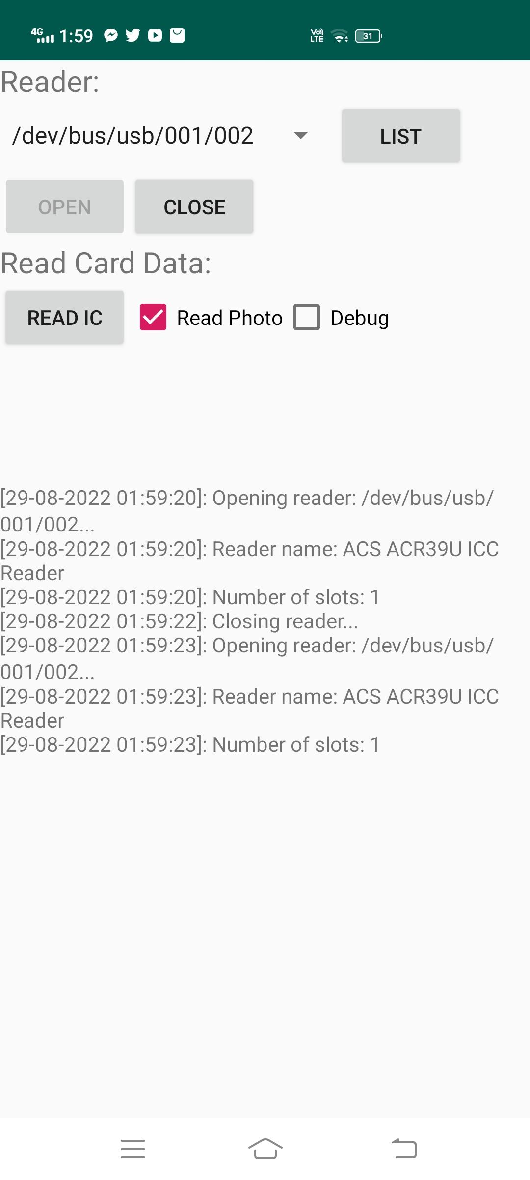
The basic Interface
Change to [Activate Reader]
Once Activated change to [Reader Active or Engage]
Change to Detect Device
Change to [Deactivate Reader]
Read IC change to [Validate Driver]

Slide 17
Select Application, Get Response
static final String SELECT_JPN_APPLICATION = "00 A4 04 00 0A A0 00 00 00 74 4A 50 4E 00 10";
static final String SELECT_APPLICATION_GET_RESPONSE = "00 C0 00 00 05";
"00 A4 04 00 0A" is the "CLA INS P1 P2 P3" for "Select Application". The data part of the APDU consists of 10 bytes: "A0 00 00 00 74 4A 50 4E 00 10". The "A0 00 00 00 74" and "00 10" parts are constant. "4A 50 4E" represents "JPN". Change to "JPJ" or "IMM" for those applications. "00 C0 00 00 05" is the "CLA INS P1 P2 P3" for "Get Response". The 5 data bytes received is not significant, but you can verify whether it is successful.
Command APDU Content Description
Code | Description | Length
CLA | Class of instruction | 1
INS | Instruction code | 1
P1 | Instruction parameter 1 | 1
P2 | Instruction parameter 2 | 1
Lc | Number of bytes present in command date field | 0 or 1
Data | String of data bytes sent in command (= Lc) | Variable
Le | Maximum number of data bytes expected in data field of response | 0 or 1

Slide 18
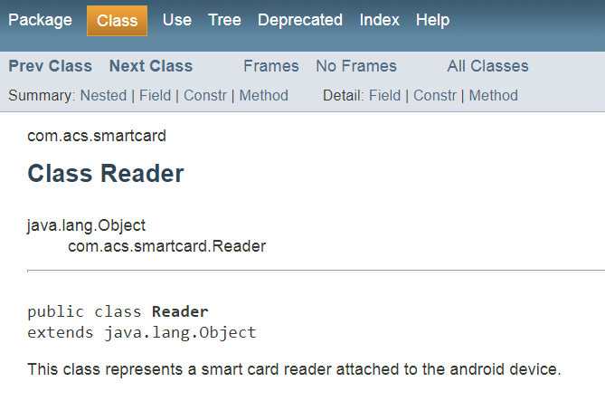
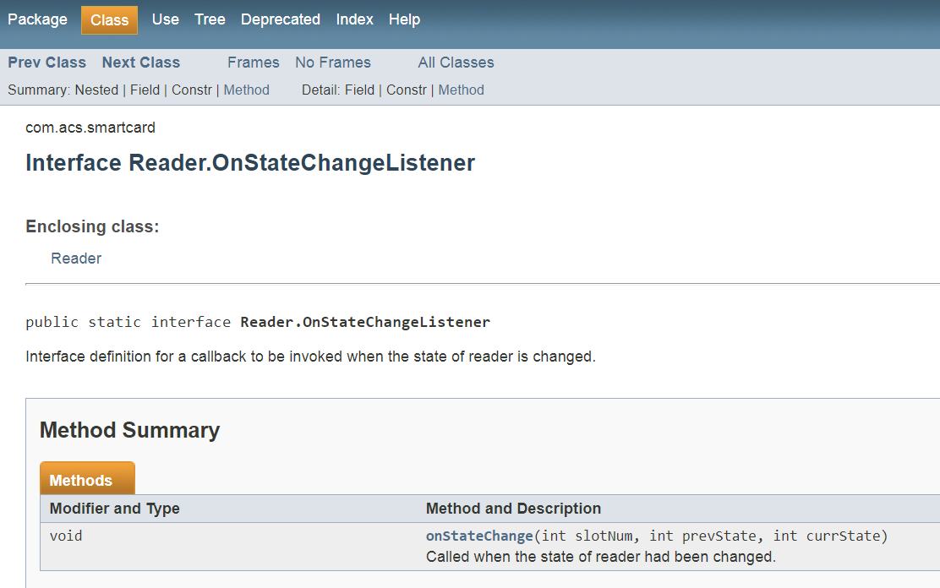
Datasheet important links

Slide 19
PCSC Interface Standard and driver
https://pcscworkgroup.com/specifications/download/
https://www.acs.com.hk/en/products/425/acr39u-nf-pocketmate-ii-smart-card-reader-usb-type-c/

